Slide 1
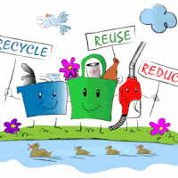
SCRAP-VEND
TEAM MEMBERS:
1)Mohammad Noman
2)Poorniam Varshney
3)Aishwarya Phulwani
4)Saif Ali

Slide 2
INTRODUCTION
“BUYING PROUDCTS ONLINE IS EASY ,BUT GETTING RID OF THEM WHEN IT BECOMES USELESS IS NOT.”
There is a need of an application that tells people what to do with the scrap collected at their house. The main purpose of this application is to ensure that all the scrap are managed in such a way that protects both public health and environment by providing an ease to the people so that they can also contribute in the cleanliness of the surroundings without working hard and spending much time.
We provide the service to collect scrap material from your location and sell it to the scrap dealers with market rates to help both.

Slide 3
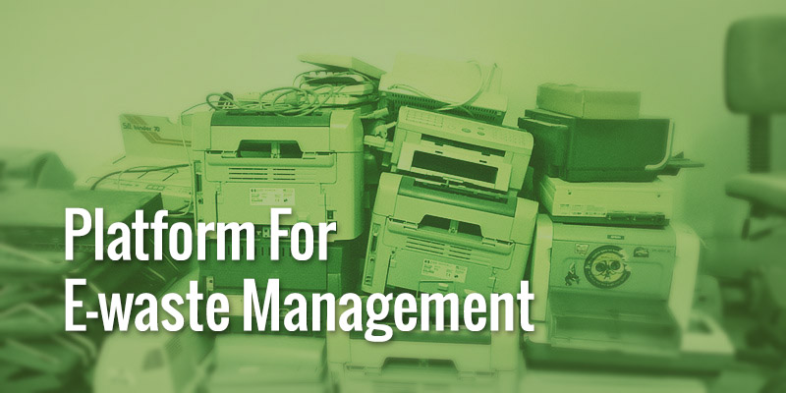
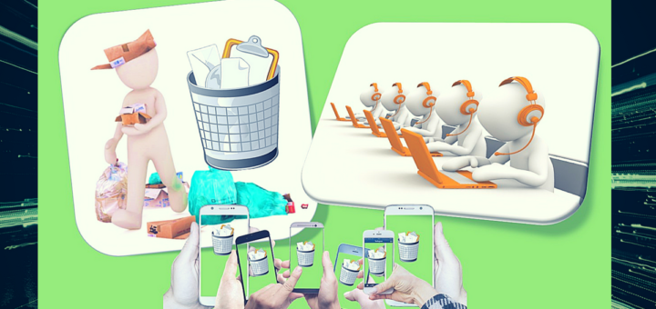
OBJECTIVE:
PROVIDES A PLATFORM
    Our platform helps to find and map assets that streamline the collection of post-consumer waste, schedule efficient & cost-effective pickups and incorporates them into vendor network.

Slide 4
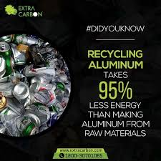
INNOVATIVE ORGANISATION
    The Scrap-Vend is an Innovative application providing the facilitates people to sell their waste online and user get properly paid for it. We provide the easiest way to people to sell their scrap at their doorstep for offices, institutions, households , schools or any place to get rid from their waste by helping the dealers to buy it.
AWARENESS AMONG THE PUBLIC
    A critical component in any application portal is public awareness and participation. Waste is the result of human activities and everyone needs to have a proper understanding of it.

Slide 5
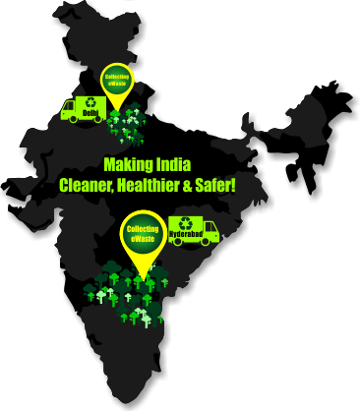
IT PROVIDE ENVIROMENT FRIENDLY SERVICES TO CREATE GO GREEN.

Slide 6
PROBLEM STATEMENT
Problem faced by people :
Nowadays due to busy schedule of people, they didn’t get time because of which they dumb all the scrap, which later causes problems.
People living in societies can't find any local scrap dealer due to high securities in their area that’s why most of them fail to sell their scrap..
Problem faced by Scrap Dealer :
Scrap Dealer need to roam around the areas screaming to gain attention.
Scrap Dealer also didn’t know how much scrap they get on daily basis due to which it cost extra effort and money.
They also need to remember the rates of different types of products and many more.
Social problem
People’s garbage goes to a landfill and gets buried and it makes a huge pile of garbage which further will become the deadliest threat to the city.
Huge Garbage piles is one of the main cause of land and air pollution.
Garbage like plastic, cans etc are hard to dispose which causes eradicating in the fertility of soil.

Slide 7
SOME FACTS
Recently supreme court said that solid waste in Delhi is a “very serious problem” and people of Delhi are required to deal with this issue , and also asked the lieutenant Governor to constitute a committee to deal with the issue.
A big part of a landfill in east Delhi’s Ghazipur collapsed recently, trapping a few people under the debris and sweeping a car and a two-wheeler into a nearby canal.
The fire at the garbage dump near the heart of the capital causes severe damage in nearby air quality.

Slide 8
OVERVIEW OF SOLUTION
By providing a hassle free online portal to seller and scrap dealer.
Frequently updating the market cost of each type of wastes.
Time flexibility for user to book a scheduled pick-up.
Prerequisite knowledge of quantity of scrap for dealer.
Improvising time management and efficiency of work for scrap dealer.
Cost effective and less tedious.
Sustainable and fuel saving.

Slide 9

SELL MORE EARN MORE AND RECYCLE MORE..
Thank you..

